Slide 1
Data Mining Topic: Rule based Classifiers
Dr. J Angel Arul Jothi
Department of Computer Science

Slide 2
Text Book Chapter 5
Section 5.1

Slide 3
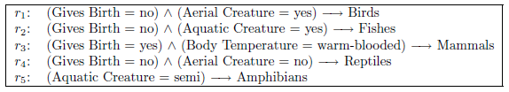
Rule based Classifiers
Represent the knowledge in the form of IF-THEN rules
R1: IF age = youth AND student = yes THEN buys_computer = yes
Rule set/rule data base
Stores all classification rules
Example of a rule set for the vertebrate classification problem

Slide 4
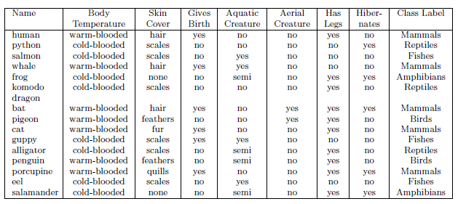
Rule based Classifiers
The vertebrate classification dataset

Slide 5
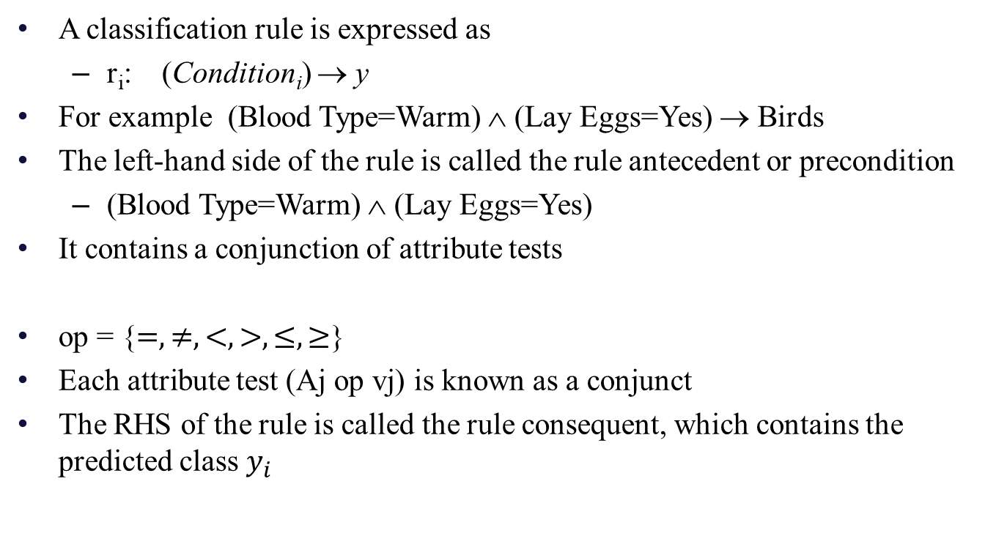
Rule based Classifiers

Slide 6

Rule based Classifiers
A rule r covers a record x if precondition of r matches the attribute values of x
r is also said to be fired or triggered whenever it covers a given record

Slide 7

Quality of classification rule
Coverage of a rule:
Given data set D and classification rule r : A −→ y
The coverage of a rule is the fraction of records in D that satisfy the antecedent of a rule (i.e., whose attribute values are the same for the rule’s antecedent).
where |A| is the number of records that satisfy the rule antecedent and
|D| is the total number of records

Slide 8

Quality of classification rule
Accuracy (confidence factor) of a rule:
The fraction of records triggered by the rule that satisfy both the antecedent and consequent of a rule
Where |A ∩ y| is the number of records that satisfy both the antecedent and consequent and |A| is the number of records that satisfy the rule antecedent

Slide 9
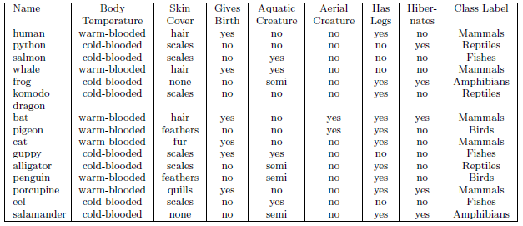
Example
(Gives Birth = yes) ∧ (Body Temperature = warm-blooded) → Mammals
Compute coverage and accuracy
Coverage = 5/15 = 0.33
accuracy = 5/5 = 1

Slide 10
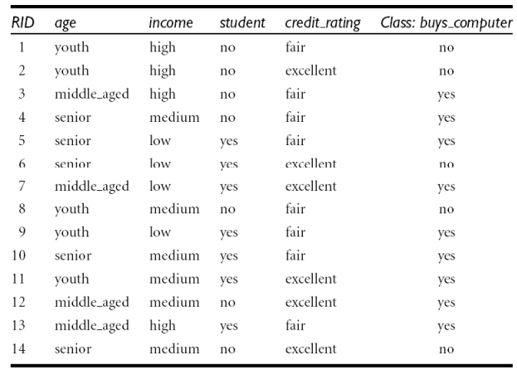
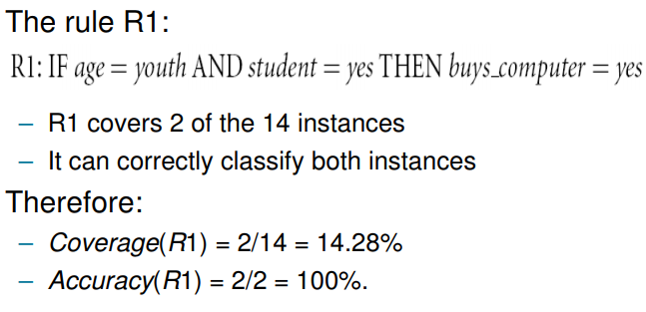
Example
Compute coverage and accuracy
Coverage = 2/14 = 0.14
accuracy = 2/2 = 1

Slide 11

How a Rule-Based Classifier Works
A rule-based classifier classifies a test record based on the consequent of the rule triggered by the record

Slide 12
How a Rule-Based Classifier Works
Consider the first record
It triggers the rule r3, and thus, is classified as a mammal

Slide 13
How a Rule-Based Classifier Works
Consider the second record
It triggers the rules r4 and r5 with conflicting classes

Slide 14
How a Rule-Based Classifier Works
Consider the third record
Does not trigger any rule

Slide 15
How a Rule-Based Classifier Works
Mutually Exclusive Rules
The rules in a rule set R are mutually exclusive if no two rules in R are triggered by the same record
Exhaustive Rules
A rule set R has exhaustive coverage if there is a rule for each combination of attribute values
These property ensures that every record is covered by exactly one rule in R

Slide 16
How a Rule-Based Classifier Works
Default rule
If the rule set is not exhaustive, then a default rule, r_{d} : () −→ y_{d}, must be added to cover the remaining cases
An empty antecedent and is triggered when all other rules have failed
y_{d} is known as the default class and is typically assigned to the majority class of training records not covered by the existing rules

Slide 17
How a Rule-Based Classifier Works
If rule set is not mutually exclusive, then a record can be covered by several rules, some of which may predict conflicting classes
Two ways to overcome this problem
Ordered Rules
Unordered Rules

Slide 18
How a Rule-Based Classifier Works
Ordered Rules
The rules in a rule set are ordered in decreasing order of their priority
An ordered rule set is also known as a decision list
When a record is presented, it is classified by the highest-ranked rule that covers the record
If none of the rules fired, it is assigned to the default class

Slide 19
Ordered Rules
The record is classified as Reptile
R1: (Give Birth = no) ∧ (Can Fly = yes) → Birds
R2: (Give Birth = no) ∧ (Live in Water = yes) → Fishes
R3: (Give Birth = yes) ∧ (Blood Type = warm) → Mammals
R4: (Give Birth = no) ∧ (Can Fly = no) → Reptiles
R5: (Live in Water = sometimes) → Amphibians

Slide 20
How a Rule-Based Classifier Works
Rule ordering scheme
Rule-Based Ordering Scheme
Orders the individual rules by some rule quality measure
accuracy, coverage, length

Slide 21
How a Rule-Based Classifier Works
Class-Based Ordering Scheme
Rules that belong to the same class appear together in the rule set
Rules are ordered in such a way that
All the rules for the most frequent class come first followed by all the rules for the next most frequent class and so on
The relative ordering among the rules from the same class is not important; as long as one of the rules fires, the class will be assigned to the test record
C4.5 rules and RIPPER use class-based ordering

Slide 22
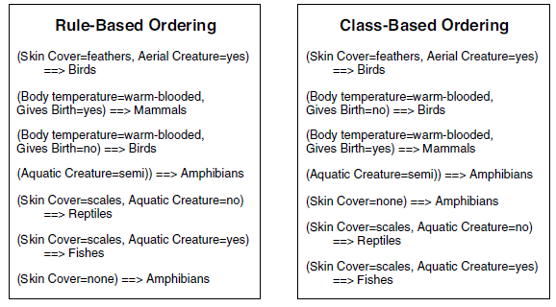
Comparison between rule-based and class-based ordering schemes

Slide 23
How a Rule-Based Classifier Works
Unordered Rules
Allows a record to trigger multiple classification rules
Consider the consequent of each rule as a vote for a particular class
The votes are then tallied to determine the class label of the test record
The record is usually assigned to the class that receives the highest number of votes

Slide 24
How to Build a Rule-Based Classifier
Direct Methods:
Extract rules directly from data
Partition the attribute space into smaller subspaces so that all the records that belong to a subspace can be classified using a single classification rule
Example: Sequential covering algorithm
Indirect Methods:
Extract rules from other Classification models
Provide a succinct description of more complex classification models
Decision Tree, Neural networks

Slide 25
Rule Extraction from a Decision Tree
Rules are easier to understand than large trees
One rule is created for each path from the root to a leaf
Each attribute-value pair along a path forms a conjunct of the rule antecedent
The label of the leaf node becomes the consequent of the rule

Slide 26
Rule Extraction from a Decision Tree
age?
<=30
>40
student?
31..40
credit rating?
no
yes
yes
excellent
fair
no
yes
no
yes

Slide 27
Rules from decision tree
Example: Rule extraction from our buys_computer decision-tree
IF age = <=30 AND student = no THEN buys_computer = no
IF age = <=30 AND student = yes THEN buys_computer = yes
IF age = 31..40 THEN buys_computer = yes
IF age = >40 AND credit_rating = excellentTHEN buys_computer = no
IF age = >40 AND credit_rating = fair THEN buys_computer = yes

Slide 28
Sequential Covering Algorithm
Used to extract rules directly from the data
A sequential covering algorithm:
The rules are learned sequentially (one rule per class at a time i.e. class-based ordering)
Criteria for deciding the class
class prevalence
Rules are grown in a greedy fashion based on a certain evaluation measure

Slide 29
Sequential Covering Algorithm
Start with an empty decision list R, training records E and a class y
Learn-One-Rule function is used to extract the best rule for class y that covers the current set of training records
Remove training records covered by the rule
The new rule is added to the bottom of the decision list R
Repeat (steps 2, 3 & 4) until stopping criterion is met
The algorithm then proceeds to generate rules for the next class
Note: During rule extraction, all training records for class y are considered to be positive examples, while those that belong to other classes are considered to be negative examples. A rule is desirable such that it covers most of the positive examples and none (or very few) of the negative examples

Slide 30
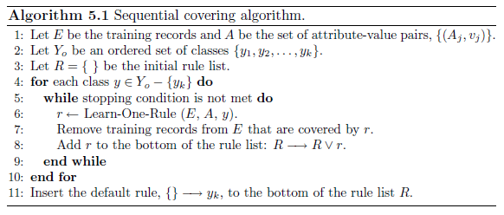
Sequential Covering Algorithm

Slide 31
Example of Sequential Covering

Slide 32
Example of Sequential Covering

Slide 33
Learn-One-Rule Function
The objective of the Learn-One-Rule function
extract a classification rule that covers many of the positive examples and none (or very few) of the negative examples in the training set
Computationally expensive as the size of the search space is exponential
Rules are grown in a greedy fashion
Generate an initial rule r
Refine the rule until a certain stopping criterion is met
Prune the rule to improve its generalization

Slide 34
Rule-Growing Strategy
General-to-specific
We start with an initial rule r : {} −→ y is created
left-hand side is an empty set and the right-hand side contains the target class
Gradually keep appending attribute tests (conjuncts) to it
This process continues until the stopping criterion is met (e.g., when the added conjunct does not improve the quality of the rule)

Slide 35
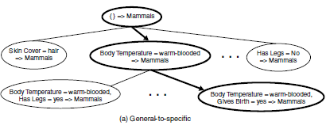
General-to-specific

Slide 36
Rule-Growing Strategy
Specific-to-general
One of the positive examples is randomly chosen as the initial seed
In the refinement step, the rule is generalized by removing one of its conjuncts so that it can cover more positive examples
The refinement step is repeated until the stopping criterion is met, e.g., when the rule starts covering negative examples

Slide 37
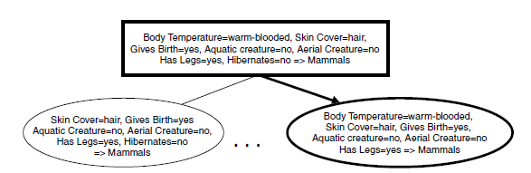
Specific-to-general

Slide 38
Rule Evaluation
Determine which conjunct should be added (or removed) during the rule-growing process
Accuracy is an obvious choice because it explicitly measures the fraction of training examples classified correctly by the rule
However, a potential limitation of accuracy is that it does not take into account the rule’s coverage

Slide 39
Why accuracy cannot be used as a measure for rule evaluation
Consider a training set that contains 60 positive examples and 100 negative examples. Suppose we are given the following two candidate rules:
Rule r1: covers 50 positive examples and 5 negative examples
Rule r2: covers 2 positive examples and no negative examples
Compute the coverage and accuracy of r1 and r2
Coverage(r1) = 55/160 = 34.3%
Coverage(r2) = 2/160 = 1.25%
Accuracy (r1) = 50/55 = 90.9
Accuracy (r2) = 2/2 = 100

Slide 40
Rule Evaluation
FOIL: First Order Inductive Learner
Foil’s Information Gain
Considers the support count of the rule (no. of +ve instances covered by a rule)
R0: initial rule
R1: rule after adding/removing conjunct
Foil’s Information Gain (R0, R1)
= p1 [ log (p1/(p1+n1)) – log (p0/(p0 + n0)) ]
where p0: number of positive instances covered by R0
n0: number of negative instances covered by R0
p1: number of positive instances covered by R1
n1: number of negative instances covered by R1

Slide 41
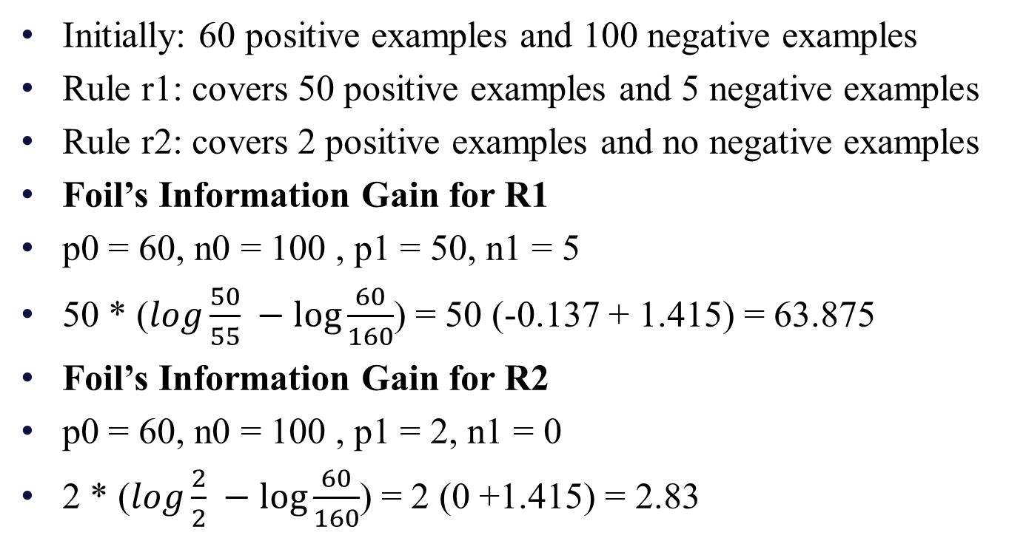
Foil’s Information Gain

Slide 42

Likelihood ratio statistic
Let k be the number of classes, f_{i} the observed frequency of class i examples that are covered by the rule, and e_{i} is the expected frequency of a rule that makes random predictions
A large R value suggests that the number of correct predictions made by the rule is significantly larger than that expected by random guessing

Slide 43
Likelihood ratio statistic
Initially: 60 positive examples and 100 negative examples
Rule r1: covers 50 positive examples and 5 negative examples
Rule r2: covers 2 positive examples and no negative examples
For R1:
Expected frequency of +ve class
55 * 60/160 = 20.625
Expected frequency of negative class
55 * 100/160 = 34.375
The likelihood ratio for R1 is

Slide 44
Likelihood ratio statistic
Initially: 60 positive examples and 100 negative examples
Rule r1: covers 50 positive examples and 5 negative examples
Rule r2: covers 2 positive examples and no negative examples
For R2:
Expected frequency of +ve class
2 * 60/160 = 0.75
Expected frequency of negative class
2 * 100/160 = 1.25
The likelihood ratio for R2 is

Slide 45
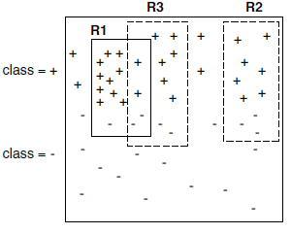
Rationale for Sequential Covering
29 positive examples and 21 negative examples
Accuracy of R1, R2, and R3 are 12/15 (80%), 7/10 (70%), and 8/12 (66.7%), respectively
R1 is generated first
Even though R2 has higher accuracy than R3, R1 and R3 together cover 18 positive examples and 5 negative examples (resulting in an overall accuracy of 78.3%), whereas R1 and R2 together cover 19 positive examples and 6 negative examples (resulting in an overall accuracy of 76%).

Slide 46
Rationale for Sequential Covering
After generating R1, it is clear that the positive examples covered by the rule must be removed
so that the next rule generated by the algorithm is different than R1
To avoid overestimating the accuracy of next rule generated
After generating R1, it is clear that the negative examples covered by the rule must be removed
To avoid underestimating the effective accuracy of next rule generated

Slide 47
Rule based Classifiers
Direct Method:
Extract rules directly from data
Examples: RIPPER, CN2, 1R
Indirect Method:
Extract rules from other classification models (e.g. decision trees, neural networks, etc).
Examples: C4.5 rules

Slide 48
Thank you

